Slide 1
Associations

Slide 2

Assigned identifier

Slide 3

POJO Associations

Slide 4
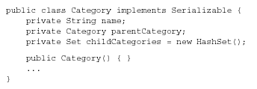
POJO class

Slide 5

Application code

Slide 6
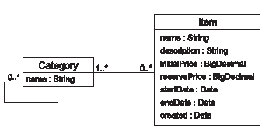
Many to Many POJO Relationship

Slide 7
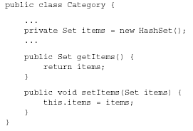
POJO class

Slide 8
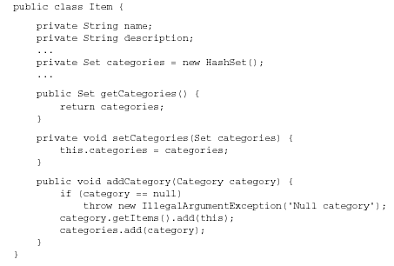
POJO class

Slide 9

Associations in HBM file

Slide 10
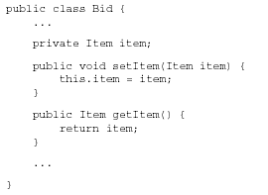
POJO class of Bid

Slide 11
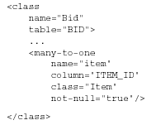
HBM mapping

Slide 12
We specified the not-null attribute because we can’t have a bid without an item.
The not-null attribute doesn’t affect the runtime behavior of Hibernate; it exists mainly to control automatic data definition language (DDL) generation

Slide 13
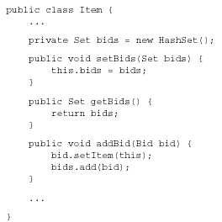
Item POJO class

Slide 14
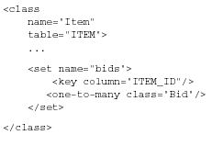
HBM mapping of Item

Slide 15
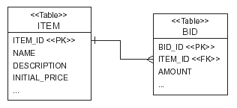
ER Diagram

Slide 16
BiDirectional Association
<class name="Item" table="ITEM">
...
<set name="bids"
inverse="true">
<key column="ITEM_ID"/>
<one-to-many class="Bid"/>
</set>
</class>

Slide 17
Cascade update
<class name="Item"
  table="ITEM">
<set name="bids"
inverse="true"
cascade="save-update">
<key column="ITEM_ID"/>
<one-to-many class="Bid"/>
</set>
</class>

Slide 18
Cascade
The cascade attribute is directional
It applies to only one end of the association.
specify cascade="save-update" for the many-to-one association declared in the mapping for Bid.

Slide 19
Parent/child relationships
The advantage of using a parent/child relationship is that the child may be loaded individually or referenced directly by another entity.
A bid, for example, may be loaded and manipulated without retrieving the owning
item.
It may be stored without storing the owning item at the same time.

Slide 20
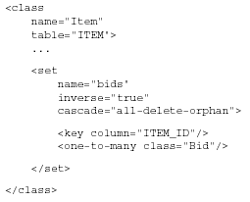
HBM mapping

Slide 21
All-delete-orphan
Any newly instantiated Bid becomes persistent if the Bid is referenced by a persistent Item
Any persistent Bid should be deleted if it’s referenced by an Item when the item is deleted.
Any persistent Bid should be deleted if it’s removed from the bids collection of a persistent Item.
A Bid will be removed from the database if it’s removed from the collection of Bids of the Item.

Slide 22
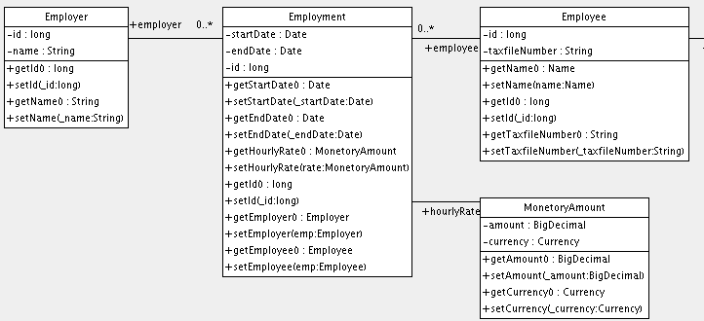
Try this

